Slide 1
Credit Card Transaction Data Fraud Detection Analysis
DSO 562, Team 112
Team Members: Freda Lin, Jingchen Liu, Pizheng Zhang, Yafan Zeng

Slide 2
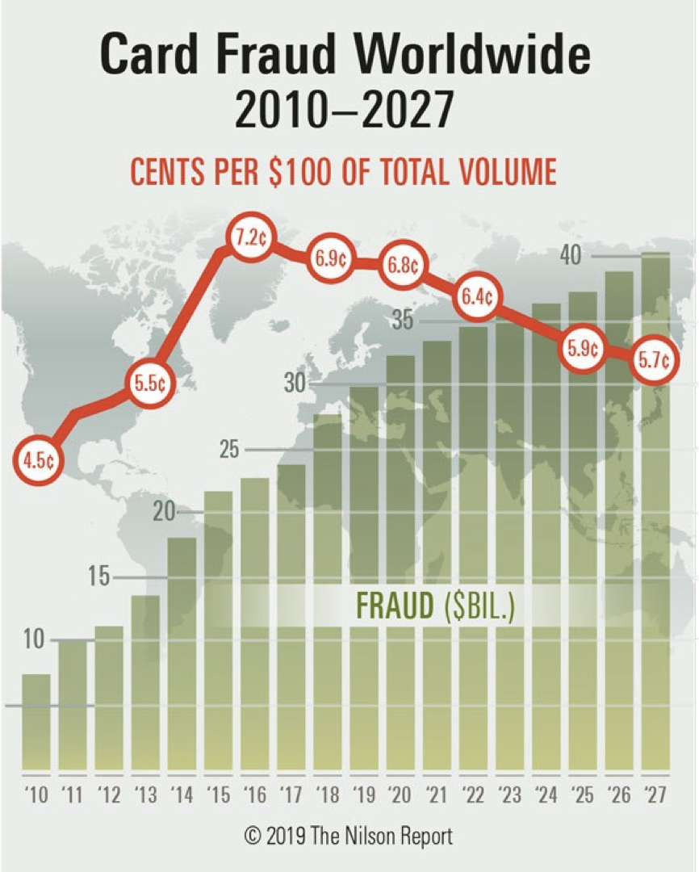
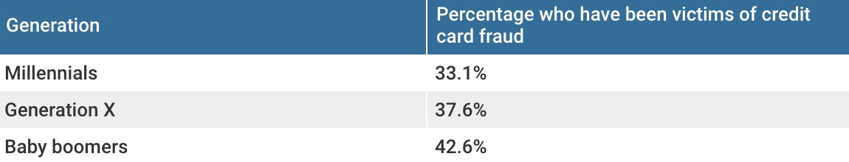
Motivation
The U.S. is #1 Cases of Credit Card Fraud
The odds of being a victim of fraud are high
Credit Card Fraud Occurrences have risen 161% from 2015 to 2020
Notes:
Can be used as beginning: https://www.cardrates.com/advice/credit-card-fraud-statistics/
The purpose of this project and why it is important to detect credit card fraud for several reasons:
According to the Nilson report, there is a 9.47 Billion dollar loss in 2018 due to illegal transactions
Moreover, Fraudster are taking advantage of Covid 19
according to the Fidelity National Information Services Inc., which is a banking fraud detection company, the dollar amount of attempted fraudulent transactions rose 35% in April 2020
The second reason is ___________, according to The Ascent’s American Credit Card Preferences and Habits Study. A third of Americans have had their identity stolen and have been victims of credit card fraud. The breakdown on who has been hit by fraudsters, as you can see on the right bottom, millennials 33.1%, generation X 37.6%, and baby boomers 42.6%.
So credit card transactions are not something rare. It might happen to many of us. The fewer people who know about fraud and protective measures, the more they can get away with their crimes.

Slide 3
Examples of Credit Card Transaction Fraud
Lost or stolen credit cards
“Card-not-present” fraud
Phishing
Card skimming
Online account hacked
Notes:
https://www.fool.co.uk/personal-finance/credit-cards/learn/4-examples-of-credit-card-fraud/
Lost: your physical credit card is missing and in hand on someone else.
CNP: criminals steal your information and use your credit card details to make payments remotely. It is one of the most common examples of credit card fraud and can take a while for cardholder to notices.
Phishing: Phishing is when you are called or emailed out of the blue asking for personal information. They may also ask for security passwords or your credit card details, which can be used to make fraudulent payments.
Card skimming: when your credit card details are copied without your knowledge using a small device. Usually in places like restaurants and bars.
Online account hacked: Things such as accidentally download malwares and spyware can enable hackers to access information stored on your computer and also unsafe public wifi networks.

Slide 4
Project Overview
1
2
3
Data Cleaning
Candidate Variables
Description of Data
6
5
4
Results
Feature Selection
Model Selection
Notes:
Here is our project overview, we used supervised machine learning techniques to build a fraud detection model based on the dataset we received.

Slide 5
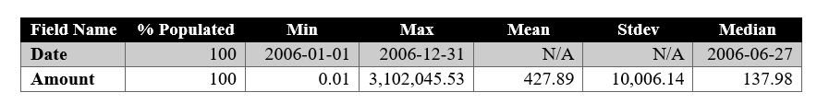
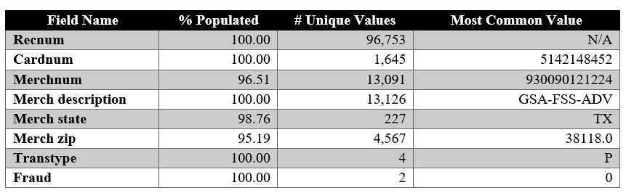
Data Description
Summary Table of Numeric Fields:
Summary Table of Categorical Fields:
Notes:
The dataset we worked on for this project is a credit card transaction purchase dataset from a US government agency. There are 10 fields and about 100,000 records. There are two numeric fields: the amount of the transaction and the data of the transaction. And there are 8 categorical fields: the record id of transaction, the credit card number in the transaction, the merchant number, merchant description, merchant state, zipcode, the transaction type. And lastly, the fraud label of each transaction, where 0 denotes a normal transaction, and 1 denotes a fraud transaction,
From the summary table, we can notice some abnormality in the dataset. Such as in the amount field, the mean is significantly larger than the median, indicating the distribution of amount is right skewed, which might be caused by some extremely large data.
In the summary table of categorical data, we noticed that there are some missing values in the merchant number, merchant state and merchant zip code fields. Therefore, in order to have as much as useable values for modeling, we should use some imputation methods to fill in these values

Slide 6
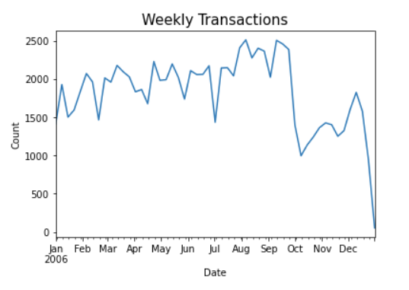
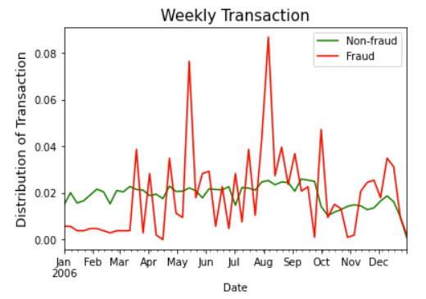
Data Description
Notes:
Oct - seasonality
In order to examine the data a little more, we plot the distribution of all fields, and there are some interesting distribution plots. The first plot is the weekly # of transactions. We noticed that there is an obvious drop in October. Because government fiscal year starts in October, so there is an intention that people would spend less at the beginning of a fiscal year and spend more toward the end of year. This also shows that there’s an seasonality in dataset.
The second graph also shows the weekly distribution of transaction but separating the transaction based on its fraud label. The green line shows the normal transaction distribution, and the red line shows the fraud transactions. Comparing to normal transactions, we can see that the fluctuation of fraud transactions distribution are more obvious.

Slide 7
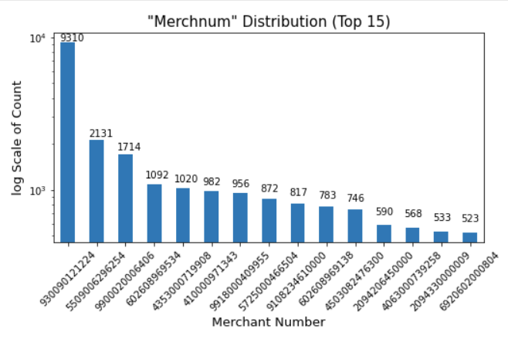
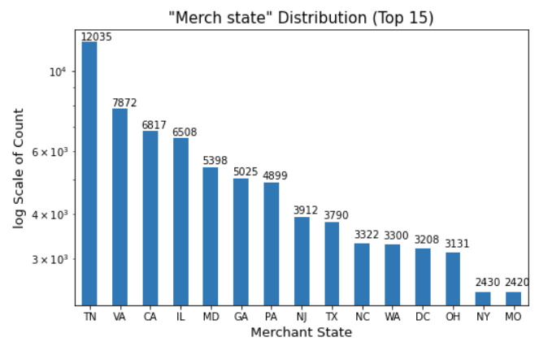
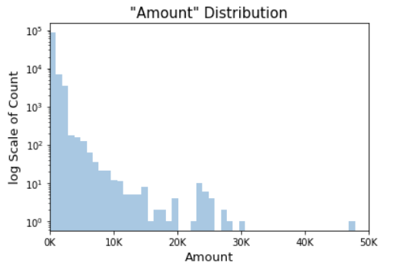
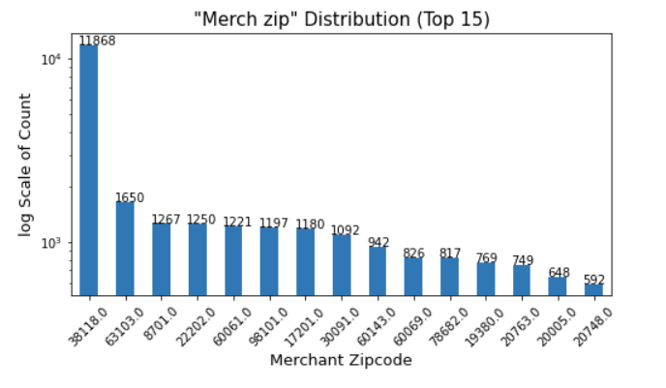
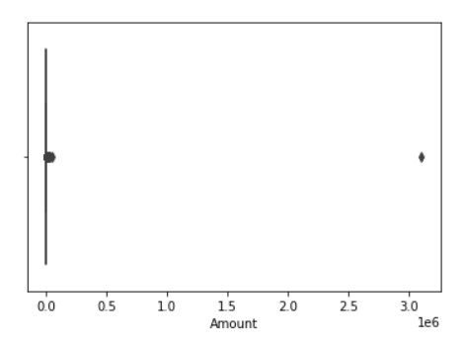
Data Description
Notes:
Here are the distribution plots of merchant number, state, zip and amount. From the first three plots, we can see that there are some values are much higher than other values, which might indicates a higher likelihood of fraud.
From the amount boxplot, there is an obvious outlier at around 3 million, so after we remove this point from the dataset, we can see the distribution of amount is reasonable.

Slide 8
Data Cleaning and Imputation
Filtering
Fill Merchnum
Fill Merch Sate
Fill Merch Zip
Removed 1 outlier
Keep only the transaction type with “P”
Data size (96,397)
Total missing: 3,198
Replace “0” with Nan (3,215)
Use mode of different fields to fill in (38)
Fill the left values with “Unknown” (0)
Total missing: 1,020
Assign “PR” to Puerto Rico Zips (980)
Assign state to records with legit U.S. zips (953)
Use mode of different fields to fill in (38)
Fill the left values with “Unknown” (0)
Total missing: 4,300
Replace single-digit zip code with Nan (4,412)
Use mode of different fields to fill in (31)
Fill the left values with “Unknown” (0)
Notes:
After understanding the data, we did the data cleaning and imputation in the following steps:
First, since we noticed that there is an outlier in the amount field, we removed this data point. Then, since we are focusing on credit card purchase transaction fraud, so we only keep the transaction with type of purchase. After the filter step, we have about 96 thousands data.
The next step is to fill in merchant number, state and zip.
There are 3,198 missing values in the merchant number,
You should describe the likely source of these frivolous values and why you need to modify them.
Dropping all transaction records other than “P” and one outlier (96,397 records remaining)
Merch state (1,020 missing)
Assign “PR” to Puerto Rico zips (980 left)
Assign state to records with legit U.S. zips (953 left)
Use the mode of different fields to fill in missing states (38 left)
Assign “Unknown” to the rest of the missing states (0 left)
Merchnum (3,198 missing)
Replace Merchnum with “0” to Nan (3,251 left)
Use the mode of different fields to fill in missing Merchnum (38 left)
Assign “Unknown” to the rest of the missing Merchnum (0 left)
Merch zip (4,300 missing)
Replace single-digit zip codes with Nan (4,412 left)
Use the mode of different fields to fill in missing zips (31 left)
Assign “Unknown” to the rest of the missing zips (0 left)

Slide 9
Variable Creation
Notes:
After data cleaning, we are going to talk about variable creation.

Slide 10
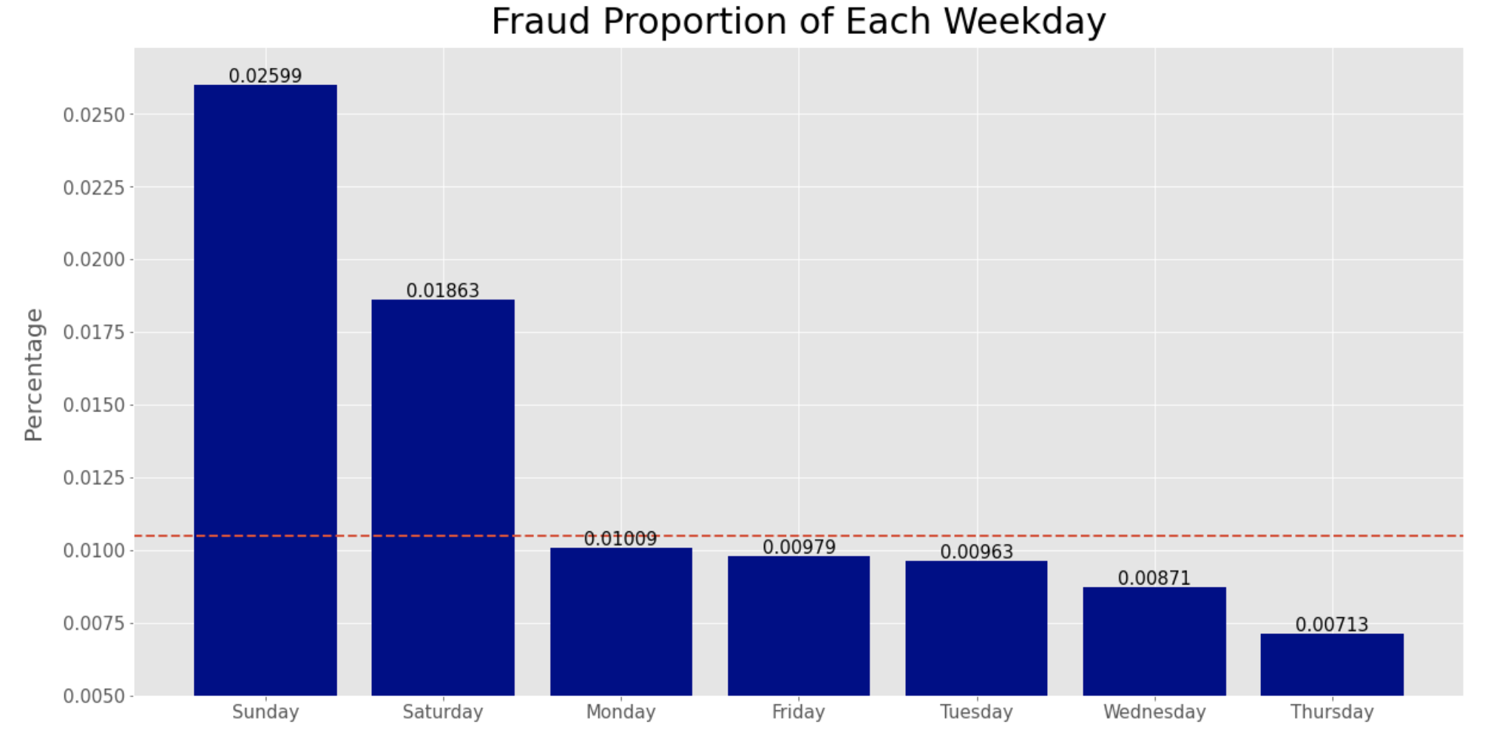
Target Encoding - DOW
Notes:
We firsted created 2 numerical variables for the day of week and state of each transaction
The purpose of encoding is to convert categorical data into numerical data.
First, We encode categorical field, but we don't want to increase dimension of the variable, so we use target encoding.
We create fraud proportion of each weekday.
We only use the first 10 months data to calculate our target encoding variable.
The numerical values here were created based on the average fraud label of each category
And we smooth the data.

Slide 11
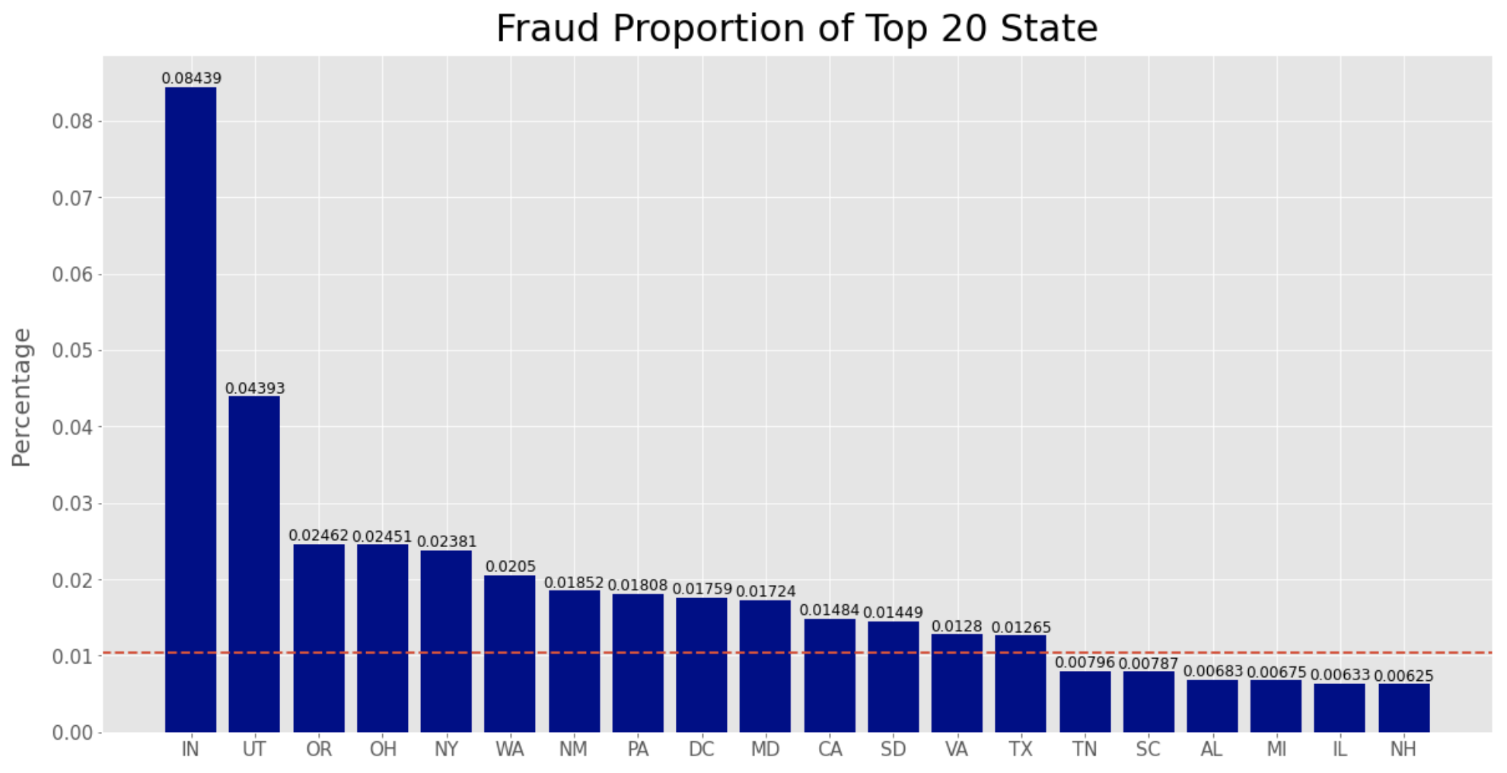
Target Encoding - State
Notes:
Similar to day of week variable
The numerical values were created based on the average fraud label of each state.

Slide 12
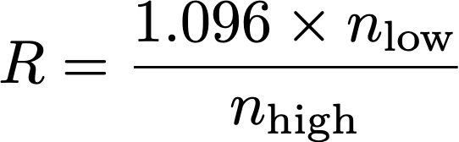
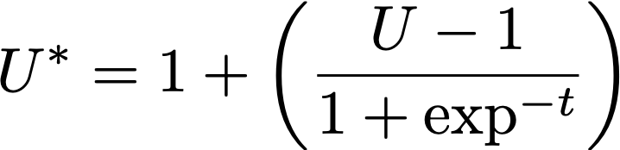
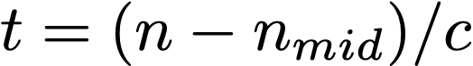
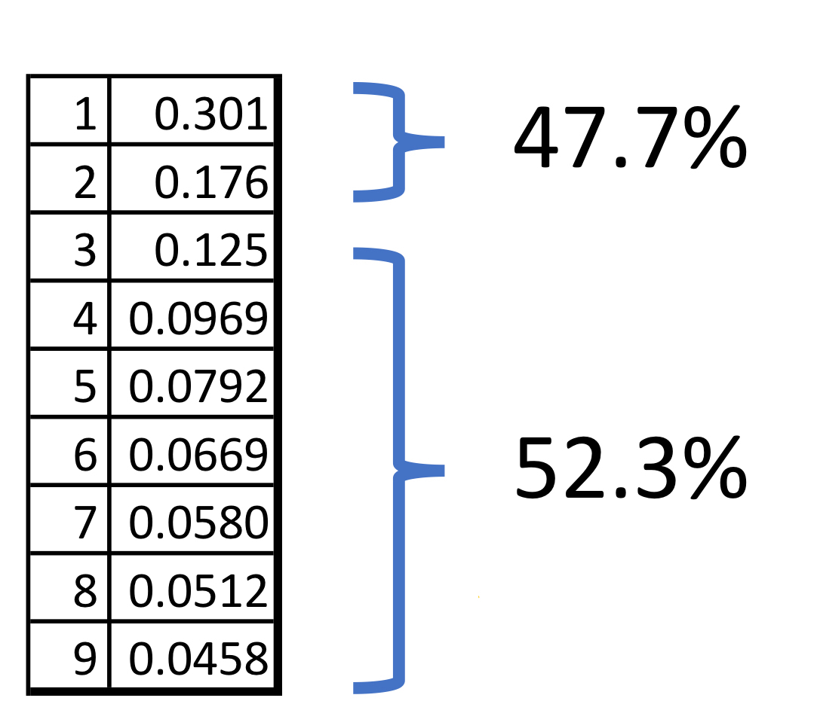
Benford’s Law Variable
Measure for Unusualness
U = max(R, 1/R)
Remove Unnecessary Data
Drop all transactions from Fedex
( C=3, nmid=15)
Step 2
Step 1
Step 3
Group Transactions Separately
Group transactions by Cardnum and Merchnum these and for each resulting group, look at the distribution of the first digit of the “purchase amount”.
Notes:
Next, we create Benford’s Law variable
Remove unnecessary Data: because we believe that the transaction from fedex may not follow Benford’s Law, so we drop all transactions from Fedex
Group transaction Separately: (Group transactions by Cardnum and Merchnum and for each resulting group, look at the distribution of the first digit of the “purchase amount”. )
Measure for Unusualness: R present the ratio of nlow and nhigh. Since the original Benford Law distribution has 9 bins, However, we dont have enough records for it. We divide it into two bins. Nlow is the count of the first digits beginning with either 1 or 2, and Nhigh is the count of the first digits beginning with 3-9. 1.096 comes from ratio of nhigh/ nlow. R should be about 1.
Thus, the measure of unusualness coube be max num of R and 1/R.
In order to reduce variance of unusualness, We use smoothed U* as our final Benford’s Law variable

Slide 13
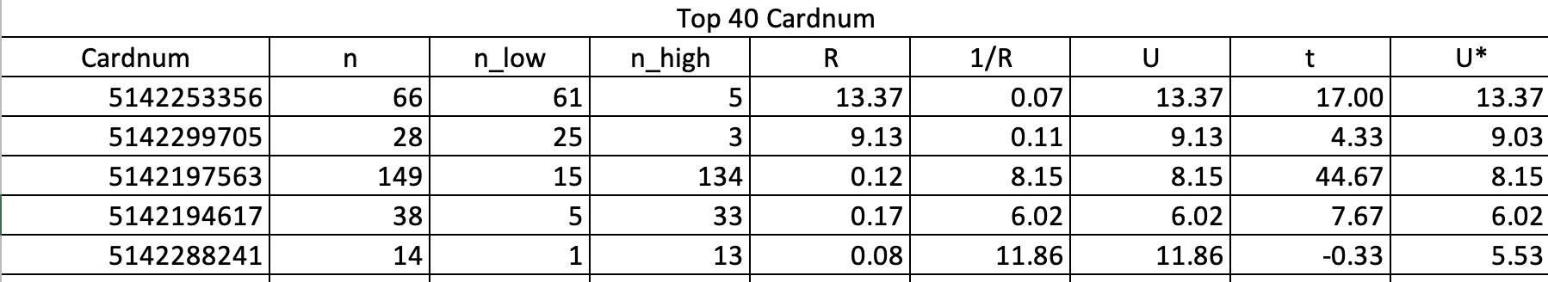
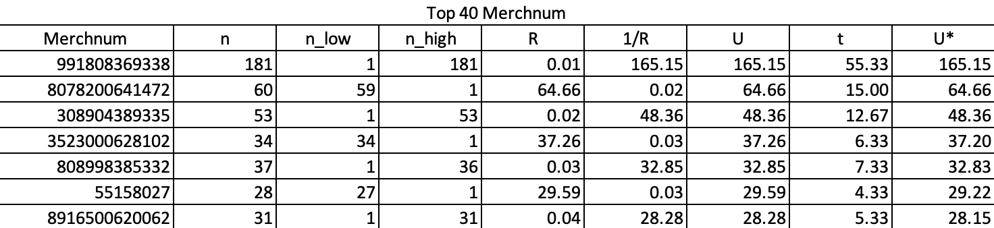
Benford’s Law Variable - Example
Notes:
Here is the final U* we use for each cardnum and merchnum

Slide 14
Motivate the Expert Variables
Purchase amounts are too big
Used same cardnum at different state or zip
Burst of activity at different merchants
Infrequent recurring charges
Notes:
Next we are going to create candidate variables. In order to create new variables, we first need to think about signal of fraud.
Some signal of fraud can be:
Amount too big: Larger than normal purchase amounts, same or different merchants
Used same cardnum at different state or zip or at a very different geographical location.
Burst of activity at different merchants but use the same cardnum
Or infrequent recurring charges at same merchants or have same amount.
All these are signal of fraud and we can use the logic to create as many as variables.

Slide 15
Candidate Variables
01
New Entities (14)
'card_zip', 'card_state', 'card_merch', 'card_merchdes', ‘Amount_date’, ‘Amount_description’, ‘Amount_state’, ‘Amount_zip’......
02
Day Since (19)
# of days since a transaction with the same entity has been seen.
03
Frequency (114)
# of transactions at that entity over the past n days. n is {0,1,3,7,14,30}.
04
Amount Variables (456)
Total/max/mean/median of transaction amount at that entity over the past n days. n is {0,1,3,7,14,30}.
05
Amount Frequency (456)
Frequency of actual Total/max/mean/median of transaction amount at that entity over the past n days. n is {0,1,3,7,14,30}.
06
Relative velocity (114)
Number of transactions at that entity within a short period of time compared to number of transactions at that entity over a longer time window n days
07
Risk variables (4)
2 target encoding variables (Percentage of fraud detect by state/day of week) and 2 Benford’s Law variables
Total variables created: 1,177
Notes:
As we mentioned before amount and cardnum are mainly signal of fraud, so we first create new entities such as cars_zip, card_state, and card_merch, and so on….. Based on the new entities and the original variable, we create 5 groups of variables listed here
day since, which presents # of days since a transaction with the same entity has been seen.
frequency, which presents # of transactions at that entity over the past n days. n is {0,1,3,7,14,30}.
amount variables, which presents Total/max/mean/median of transaction amount at that entity over the past n days. n is {0,1,3,7,14,30}.
amount frequency, which presents Frequency of actual Total/max/mean/median of transaction amount at that entity over the past n days. n is {0,1,3,7,14,30}.
Relative velocity, which presents Number of transactions at that entity within a short period of time compared to number of transactions at that entity over a longer time window n days
And Finally, risk variables which include 2 target encoding and 2 Benford Law variables.
We totally create one thousand one hundred and seventy seven variables

Slide 16
Feature Selection

Slide 17
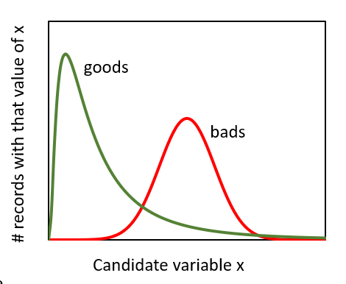
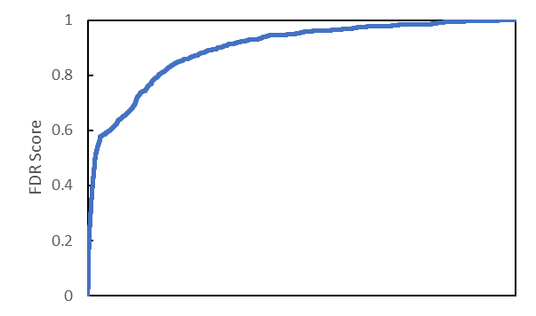
Feature Selection - Filter
Notes:
As for the feature selection process, we divided our process into two steps: Filter and wrapper.
In the filter process, because this is a binary classification problem, we decided to use univariate Kolmogorov-Smirnov (KS) method.
This method measures the separation between good records and bad records distribution curves, which means a higher KS score indicating this variable is a stronger separator as a classification feature.
We also use fraud detection rate as one criteria in the filter process. For each field, we sorted the dataset by values and then calculated the number of fraud transactions detected from the first 3% records. We used the average score the KS score and FDR score as the final filter score. We kept the top 80 relevant features for next step

Slide 18
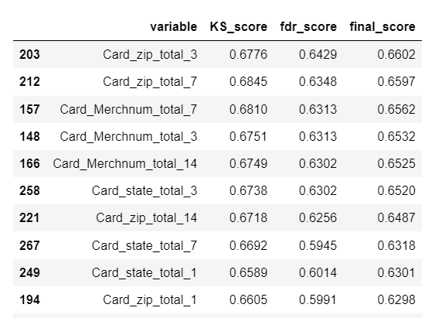
Feature Selection - Filter

Slide 19
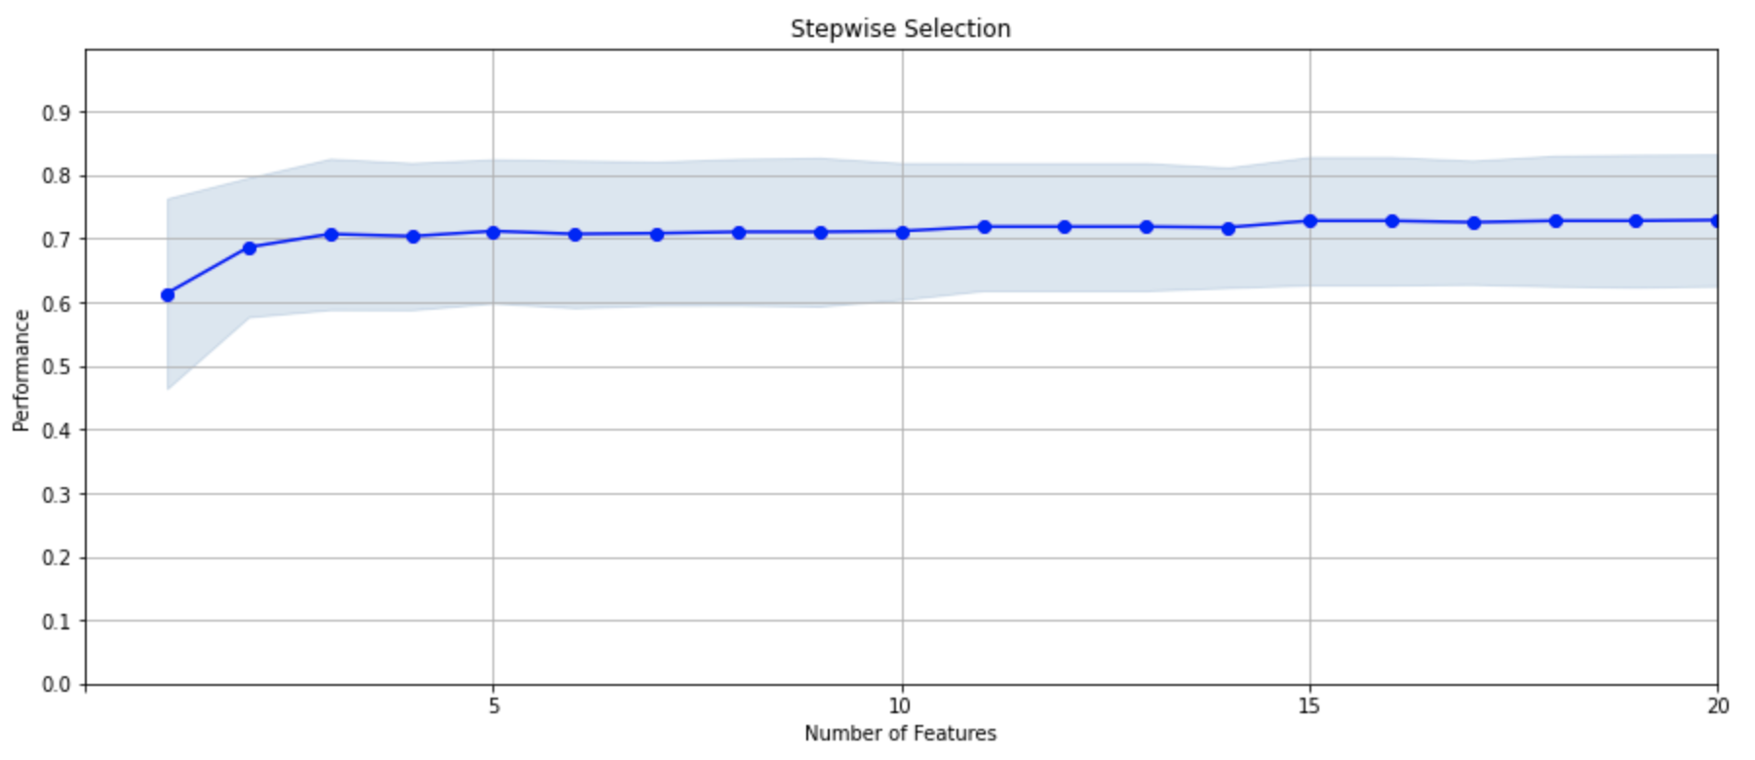
Feature Selection - Wrapper
Notes:
Wrapper process is based on a specific learning algorithm that we are trying to fit on a given dataset and it follows a greedy search approach by evaluating all possible combinations of features against the evaluation criterion. In this case, we used forward selection based on boosted tree model, and accuracy as the evaluation criterion.
Thus, we got the good subsets of 30 variables. The graph here shows variable performance in the wrapper process

Slide 20
Modeling
Notes:
after we selected our final 20 variables, We then started our modeling process
We firsted Z scaled all vars, used the last two month of data as our out of time, and the rest as our training & testing set
We then splitted 30% of our data into testing set and 70% as training set for model fitting

Slide 21
Model Fitting and Tuning
Model | Training | Testing | OOT
Logistic Regression | 60.05% | 59.24% | 25.92%
Decision Tree | 74.03% | 70.48% | 53.63%
Gradient Boosted Tree | 76.17% | 76.12% | 54.41%
Random Forest | 80.73% | 76.11% | 58.1%
Neural Network | 73.2% | 71.33% | 56.37%
Variables Used: 20
Final Model Hyperparameters:
N_estimators: 12 Criterion: gini Max_depth: 14
Min_sample_leaf: 70 Min_sample_split: 10 Max_feature: auto
Notes:
During the fitting process, we tested various model algorithms and hypertuned their parameters - for each model, we started with simple/default parameters, increase the model complexity until we have overfitting
And for each trial, we ran the model 10 times and took the avg test result as the output since we have a small dataset and number of bads
We also did manual cross validation for each model by re-splitting the training & testing set so that we don’t reduce training set size to ensure the consistency of model results
And for our final model selection: we picked the one with a high OOT Fraud detection rate and relative close FDR for the training and testing sets
As you can see from the summary table here, our final model is a random forest with 12 trees, 14 layers, a split criterion of gini impurity, min_sample_leaf of 70, min_sample_split of 10, and the max number of features used in each tree is 20
: min 70 nodes present in a leaf node after splitting, min_sample_split: require min 10 observations in any node to split, allows use all the features available in each tree

Slide 22
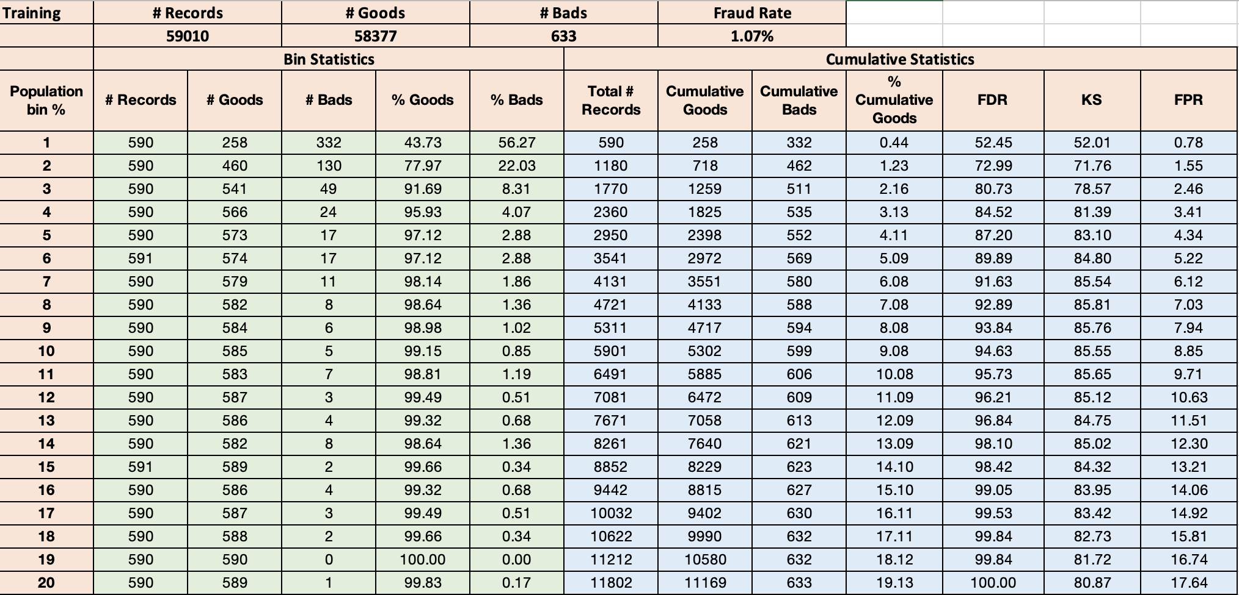
Results - Training
Notes:
And here’s the final results for our dataset after we implement our final model.
As you can see from the table here, we have a Fraud detection rate of 80.7% at 3% for the training set

Slide 23
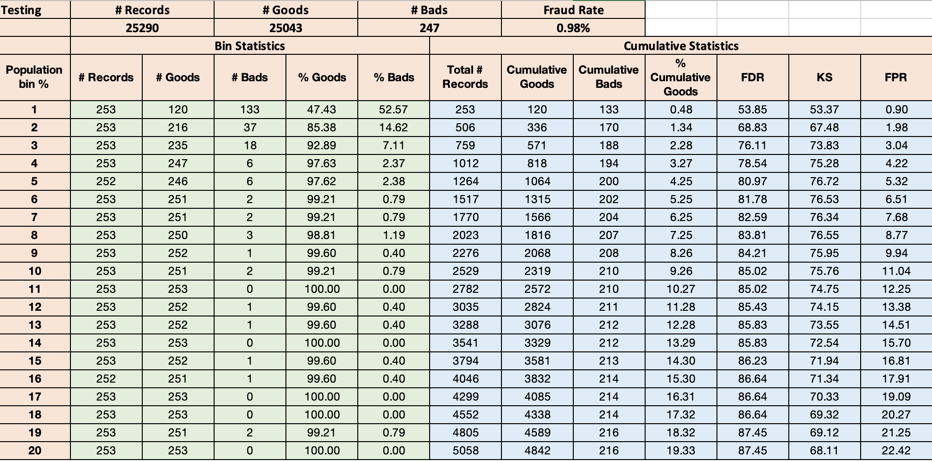
Results - Testing

Slide 24
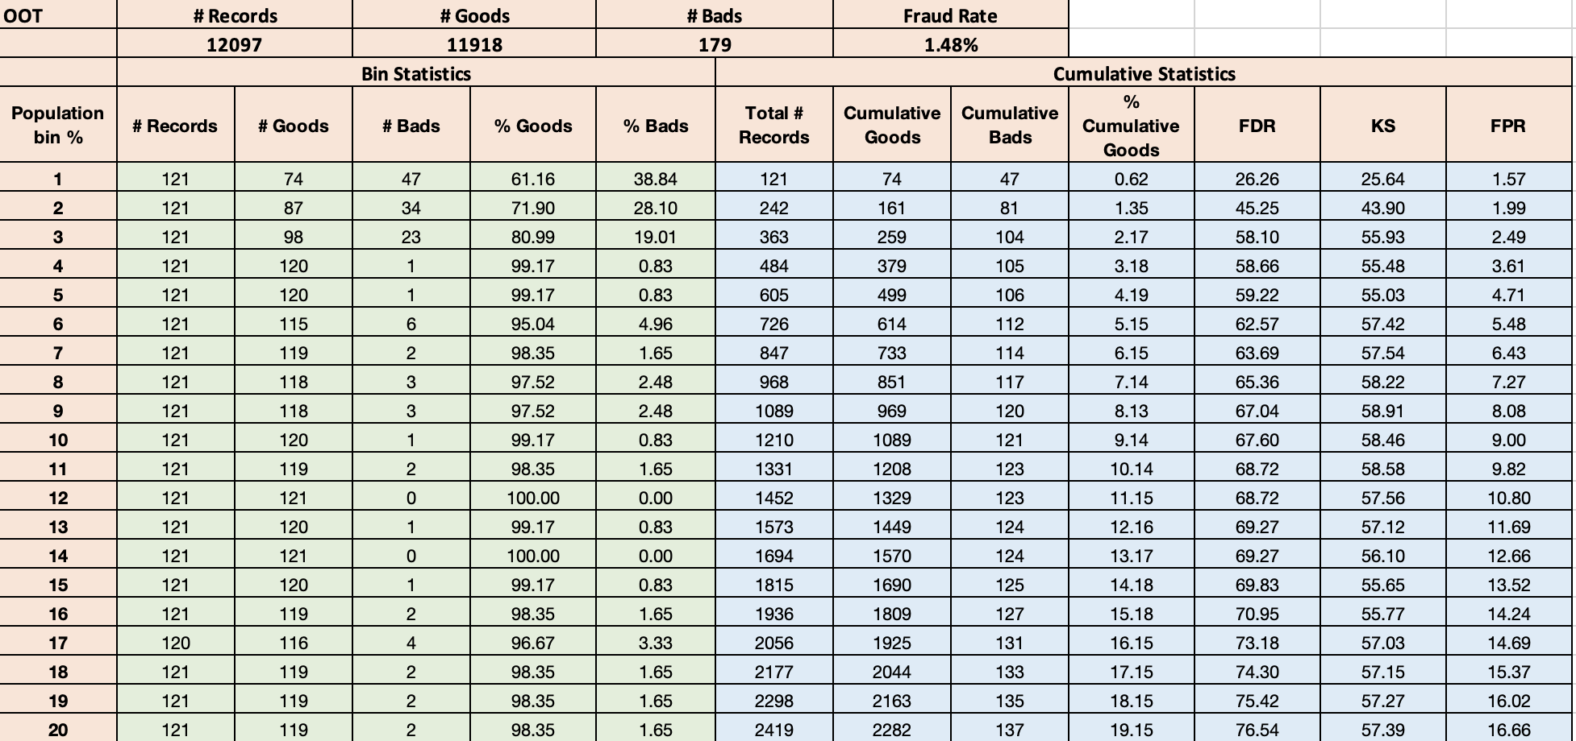
Results - OOT

Slide 25
Top 5 Variables
Variable | KS Score
card_zip_total_3 | 0.6776
card_merch_total_14 | 0.6750
card_state_total_7 | 0.6697
card_zip_total_0 | 0.6099
card_merch_total_0 | 0.6112
Notes:
And here are the top five variables by their importance in our final model along with their KS scores
And they are all card related amount variables which matched the typical signals of fraud transactions

Slide 26
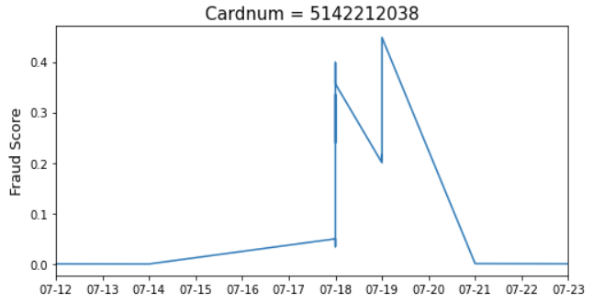
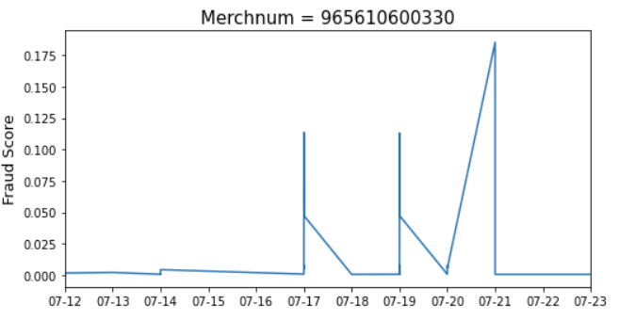
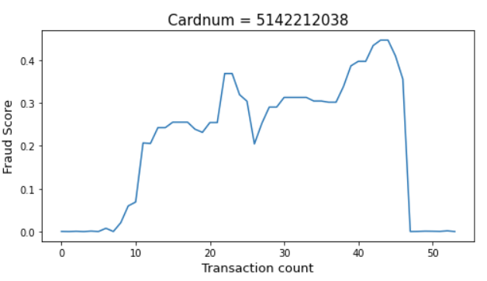
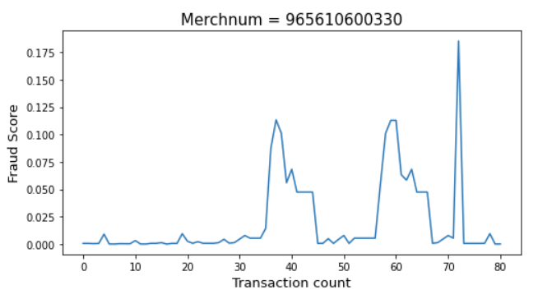
Time Dependency of Fraud Scores
39 Transactions within 2 days:
18 (33%) on 7/18
21 (39%) on 7/19
17 (21%) Transactions on 7/17
21 (26%) Transactions on 7/19
2 (2%) Transactions
on 7/21
Notes:
With our final model, we were able to go back to the original dataset and examine the time dependency of our fraud score
Here we picked two examples that can help you visualize the concept: we have plotted a 10-day fraud score graph for one cardnumber and merchant number shown on the slide
By plotting the fraud score change for that card number as shown on the left, we see a spike on the graph between 7/18-7/21 because there were 39 transactions happened within that 2 days, which is about 72% of its total transactions throughout the year. And if we take a closer look at the cumulative transaction count vs. fraud score plot on the bottom, we can see that the fraud score doesn’t go to the top immediately at the first few transactions on the July 18th. This is because Fraud score takes time to recognize a flow of unusual transactions. In this case, the first few transactions look normal to the model. They will then start to look more suspicious and their fraud score will rise rapidly afterward
Similarly, for the transactions at the merchant number we selected on the right, about 50% of its annual transactions happened within 5 days, and this explains why we have 3 peaks on July 17th, 19th, and 21st. And if we look at their fraud score by transaction cout, we can also see that Fraud score takes time to increases with activity, and the 3 jumps on the bottom right matches the 3 rapid increases in the transactions on the 3 days we identified on the top.

Slide 27
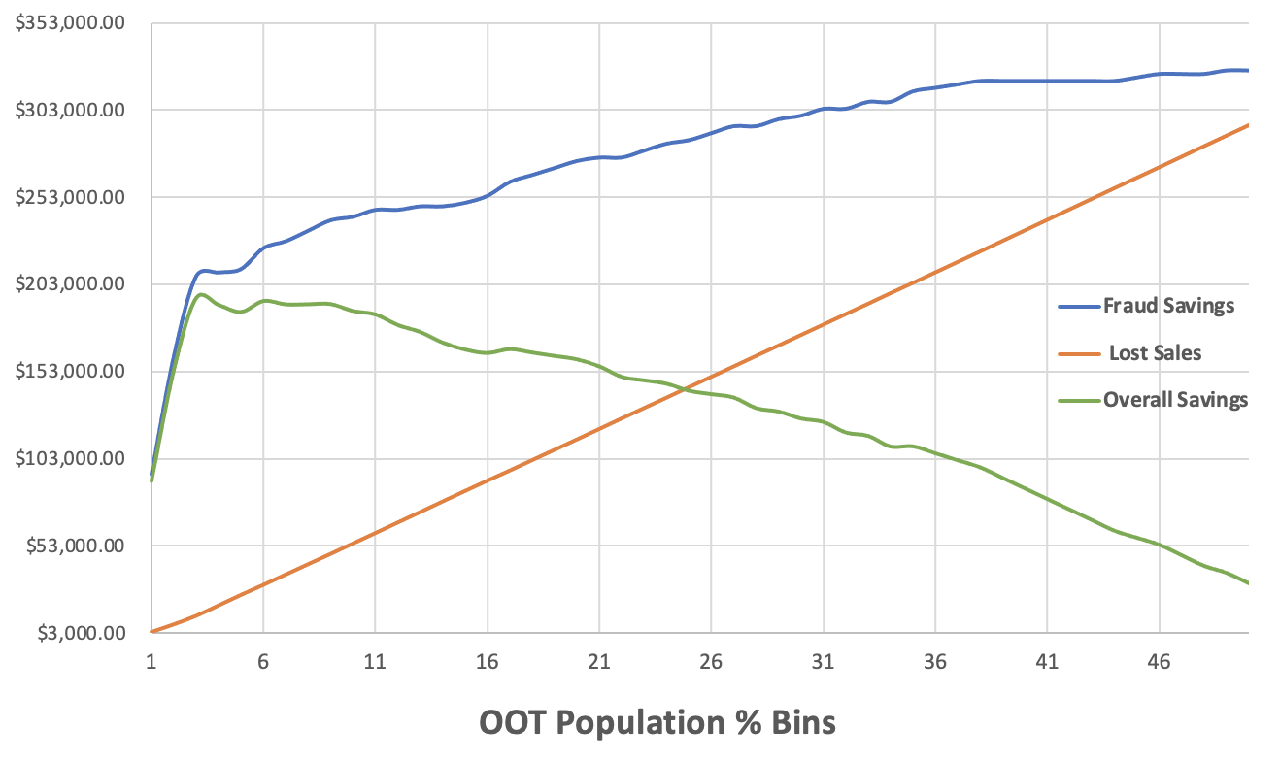
Financials by Cutoff
3%
Assume $2,000 gain for each fraud caught
Assume $50 loss for each false positive
Recommend cutoff: 3%
Max annualized savings:
~ $1,170,000
Notes:
We then looked at the financials of our model by plotting the estimated savings, lost sales, and overall savings across different bins of the out of time population on the slide here.
For the dollar amount, we assumed $2,000 gain for each fraud we caught, $50 of loss for each false positive that we will decline. With the comparison, we recommend a cutoff point at 3% here because this would maximize our overall savings (which is the green line) and also push the cutoff as left as possible so that we don’t lose too many transactions
And after our analysis, we believe that we could have a total overall saving of about $195,000 by implementing our model and setup the cutoff line at 3%

Slide 28
Conclusion
Our model can eliminate 58.1% of the fraud
by declining 3% of transactions
Notes:
After all the investigation we did, we come out with the conclusion that
We can catch more than 50 percent of the fraud, so it’s very beneficial to use the model to catch credit card fraud.

Slide 29
Areas to Improve
1
Ask domain experts for opinions and advice
2
Balance Data: Fraud vs Good distribution (1%)
3
More models for model algorithms
Notes:
When creating new variables
Such as down sample or up-sample to balance the data
We haven’t try KNN and SVM. There are some computation limitation, so we would like to try these models if we have more time.

Slide 30
Thank you!

